Slide 1
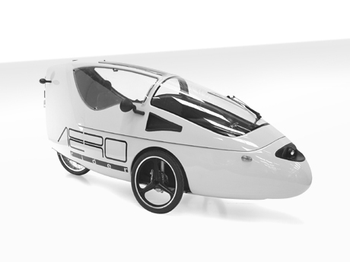
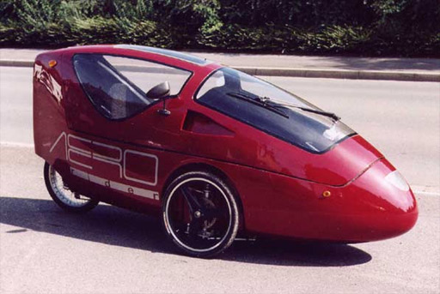
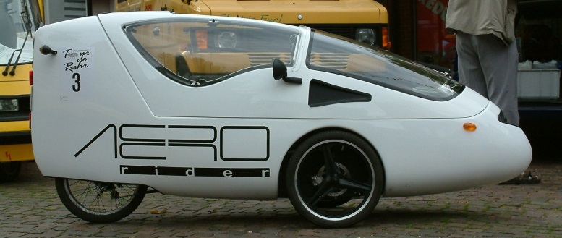
“What is the ideal shape and size for an electric assist bicycle?”

Slide 2
Appearance
Decals
Paint job

Slide 3
Shape
Aerodynamic like raindrop
Dealing with snow buildup?
Partially covered back wheel
Fully covered back wheel could collect a lot of snow

Slide 4
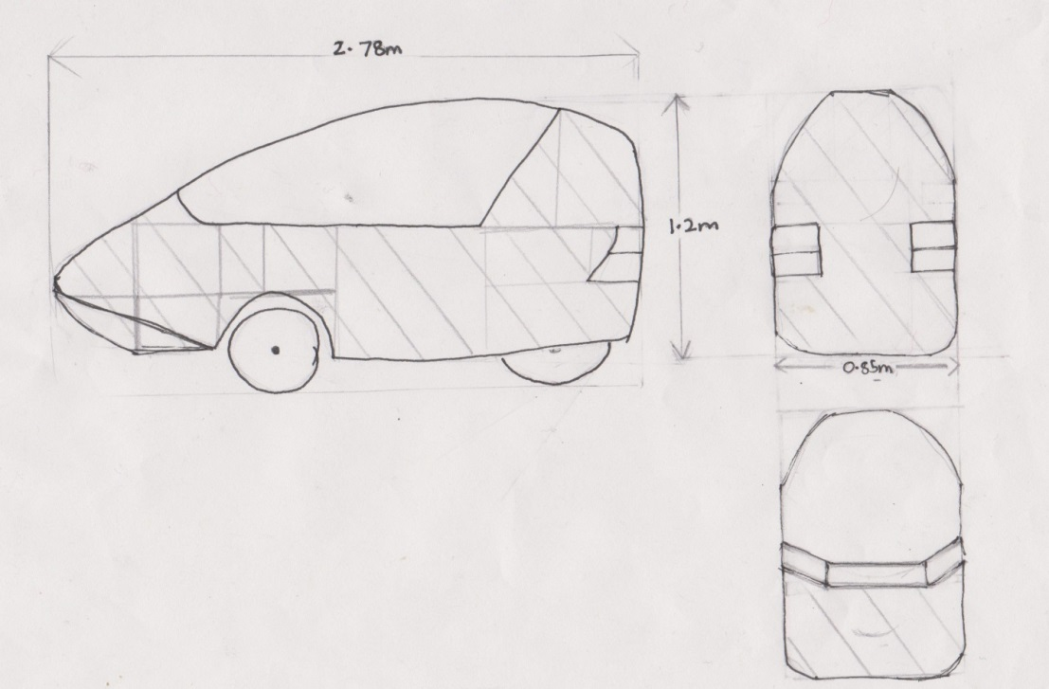
Dimensions
2.78m long by 0.85m wide by 1.20m high
Surface area: Front:(Pi x radius x slant height) + Back:(1.2x0.85)+ Sides:2 x(0.6x1.2) =2.0+1.02+1.44 <4.5metre squared

Slide 5
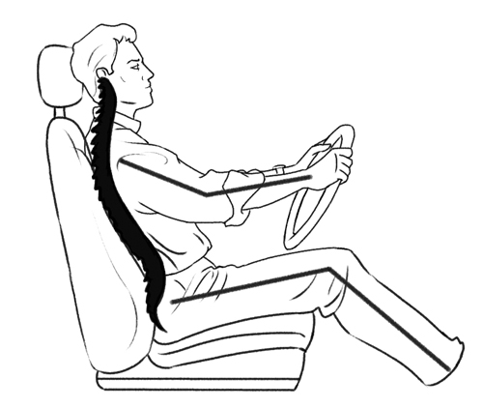
Ergonomics

Slide 6
Comfort

Slide 7
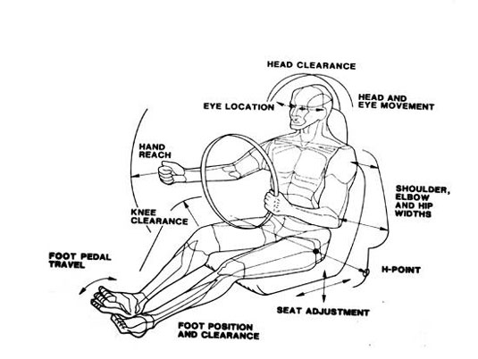
Adjustability

Slide 8
Adjustability

Slide 9
Materials
(1) Housings of Electrical Components
(2) Outer “Shell” of Vehicle
Engineering Principles:
Durability and Strength to Weight Ratio

Slide 10
Electrical Housings
Glass Filled Polycarbonate
Table 1 : Compressive strengths of Polycarbonate
Plastics International (2013) Zelux (Glass Filled Polycarbonate) [Online] Available: http://www.plasticsintl.com/datasheets/Polycarbonate_40_GF.pdf
http://www.youtube.com/watch?v=7TDnPLHXbyI

Slide 11

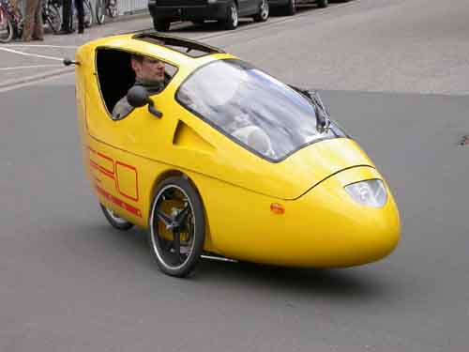
Outer Shell
Glass-Fiber Reinforced Polyester
[1] [2] [3]
[1] http://www.solarwebsite.nl/en/2007/08/proefrit-aerorider/
[2] http://www.velovision.com/showStory.php?storynum=607
[3] http://www.examiner.com/article/aerorider-the-ultimate-single-seat-hybrid
Total Weight:
Total Price:

Slide 12
Frame
Force Distribution
Wheel Base
Seat Placement
Centre of Mass
Seat Height

Slide 13
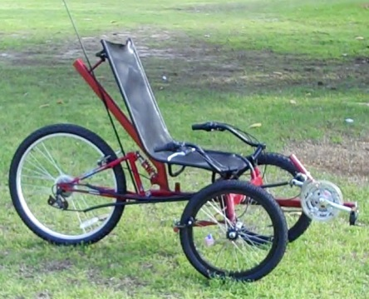
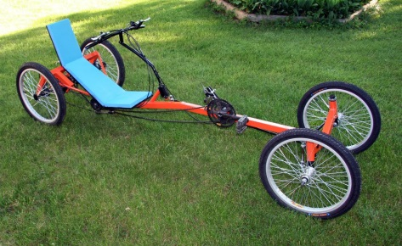
Wheel Base
Long→165-180cm
Short→83-114cm
Compact Long→114-165cm
120cm

Slide 14
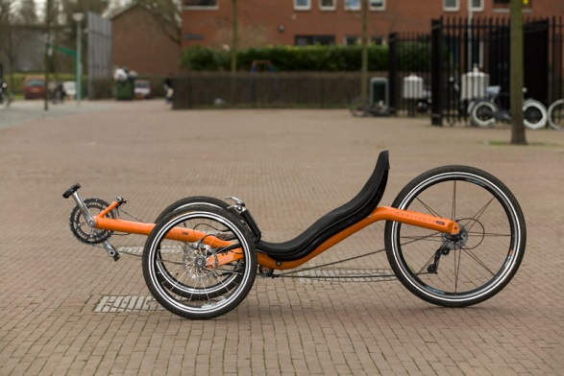
Seat Placement
70/30→ closer to the front tires
84cm
By the rear tire
Flip backwards
Less sturdy
By the front tires
Flip forward
Bumpy ride

Slide 15
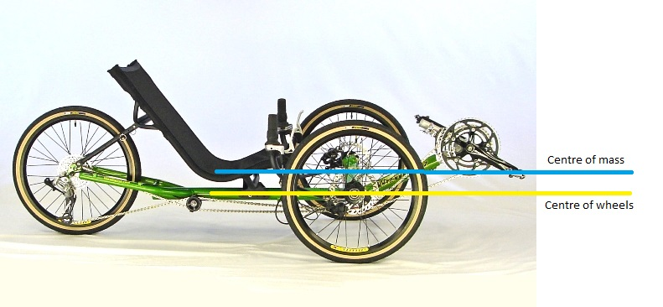
Seat Height
Even with the centre of tires
Good Visibility
Sturdy

Slide 16
Locking and Security
3 Principles:
Simplicity
Durability
Effectiveness
Primary option
Secondary option

Slide 17
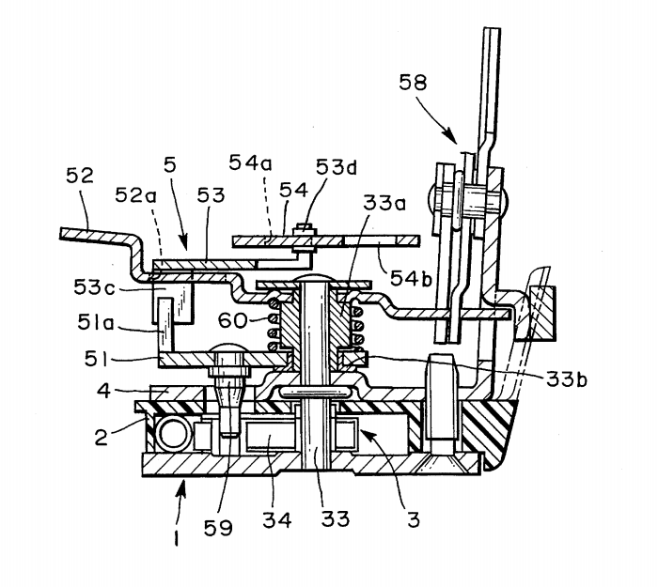
Primary Option
Primary option is to incorporate the existing vehicle door lock into the door of the recumbent tricycle
Final weight will be about 9 kilograms

Slide 18
http://www.youtube.com/watch?v=I5pA_8Ut_J4

Slide 19
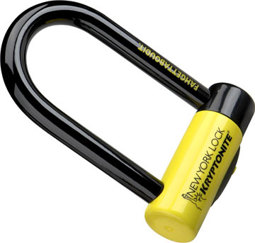
Secondary option
Secondary option is to use a standard bike lock and attach it to either the frame or an exposed wheel

